Slide 1
American Express Challenge 2020 Soyeong Bak, Dabeen Oh, Emmanuel Ren
Artificially intelligent
ChatBot
for travel recommendation

Slide 2





Table of Contents
Business insights
NLP technology behind our chatbot
The main components of our chatbot
Further developments

Slide 3











Business insights into the chatbots applied to the travel industry
Common Use Cases of chatbots applied to travel
Bain’s Elements of Value
Reservation agent
Saves time
Local insider
Informs
Reduces effort
Personalised travel plans
Avoids hassles
After-sales service
Simplifies
Travel chatbots offer multiple services, from suggesting transportation and places to visit to resolving after-sales queries, thereby creating value for customers.
Conclusion
Notes:
Travel recommendations chatbots can be used as reservation agents by assisting customers with
booking flights or hotels
as a local insider by allowing travelers to experience cities through local recommendations.
They can also
personalize travel plans
resolve after-sales inquiries.
Chatbots create many values for customers: in addition to saving time, they inform and reduce effort (customers spend less time and effort searching for relevant information).
They also avoid hassles and simplify by unifying customer experience within a single platform.

Slide 4
Chatbots can improve the customer experience at every stage of the travel
CUSTOMER JOURNEY in American Express Travel
Planning travel
Booking flight or hotel
Finding activities, restaurants or pubs
After-sales support
Customer asks for help with travel plan
Chatbot provides travel recommendations, tips
and information
Customer provides
requirements
Chatbot finds the best personalised offers
Customer sends vague queries
Chatbot recognizes and uses the trigger words to suggest relevant options
Customer makes inquiries
Chatbot resolves simple customer support questions quickly
Chatbots give relevant suggestions and personalised offers to help customers from planning their travel to booking for flight or hotel and finding local places and activities.
Chatbots can also provide after-sales support by solving simple inquiries quickly.
Conclusion
Notes:
Chatbots play the role of a travel assistant by supporting customers at the 4 stages of their travel.
At the stage of planning trip, chatbots can provide travel recommendations.
When booking flights or hotels, chatbots can suggest the best offers suited to customer requirements.
Chatbots can also help customers find local activities and restaurants by using the trigger words in the customers’ queries.
Finally, at the stage of after-sales support, chatbots can resolve simple inquiries quickly.

Slide 5



What is Bidirectional Encoder Representations from Transformers (BERT)?
Attention mechanism:
Multi-head self-attention mechanism to take into account the context from every other tokens
Mask tokens:
15% of the tokens are masked for pre-training which makes the model bidirectional
To improve transferability in a real-world application, the masked token is replaced by [MASK] (80%), a random token (10%) and itself (10%)
IS NEXT
Next Sentence Prediction:
The sentences used in training are in pair: 50% are related (IS NEXT) 50% are unrelated (NOT NEXT).
The pre-trained model learns cross-sentence consistency through the next sentence prediction training.
Input
[CLS]
my
dog
is
cute
[SEP]
he
likes
play
##ing
[SEP]
Token
Embeddings
E_{[CLS]}
E_{my}
E_{dog}
E_{is}
E_{cute}
E_{[SEP]}
E_{he}
E_{likes}
E_{play}
E_{##ing}
E_{[SEP]}
Segment
Embeddings
E_{A}
E_{A}
E_{A}
E_{A}
E_{A}
E_{A}
E_{B}
E_{B}
E_{B}
E_{B}
E_{B}
IS NEXT
Position
Embeddings
E₀
E₁
E₂
E₃
E₄
E₅
E₆
E₇
E₈
E₉
E₁₀
The Bert model takes into account the meaning, the order of the words and the context thanks to a well-designed coupling of attention mechanism with token masks and next sentence prediction
Gives state-of-the-art predictions for a wide range of different NLP tasks
Conclusion
Notes:
We used the BERT model to build our chatbot, so we’ll explain what BERT is.
BERT makes use of Transformer, an attention mechanism that learns contextual relations between words (tokens) in a text.
Before feeding word sequences into BERT, 15% of the input words are masked for pre-training, which makes the model bidirectional (the model learns the context of a word based on all of its surroundings – the non masked words)
The Next Sentence Prediction consists in training the system to predict if the second sentence in a pair of sentences is the subsequent sentence or not.
This chart describes the Transformer Encoder.
For the input, we’ll have a pair of sentences “My dog is cute” separator “he likes playing”.
To get the token representations, we sum the three embeddings (the token embedding which are word pieces, the segment embedding which represents each sentence and the position embedding) and we are going to use those in a transformer model.

Slide 6
Pre-training and fine-tuning process for travellers’ intent predictions
NSP
Mask LM
Mask LM
BERT
C
T_{t}
T_{N}
T_{[SEP]}
T₁'
T_{M}'
E_{[CLS]}
E_{t}
...
E_{N}
E_{[SEP]}
E₁'
...
E₁'
[CLS]
Tok 1
...
Tok N
[SEP]
Tok 1
...
Tok M'
Masked Sentence A
Masked Sentence B
Unlabeled Sentence A and B Pair
Pre-training
Notes:
After training the model on this basis for masked words and next sentence or not, we can take this pretrained model and fine tune it to use it for a particular task.

Slide 7
Pre-training and fine-tuning process for travellers’ intent predictions
Our Dataset
Intents
BERT
C
T_{t}
T_{N}
T_{[SEPT]}
T₁'
T_{M}'
E_{[CLS]}
E_{t}
...
E_{N}
E_{[SEPT]}
E₁'
...
E₁'
[CLS]
Tok 1
...
Tok N
[SEPT]
Tok 1
...
Tok M'
Questions
Question / Intent Pair
Fine-Tuning
Notes:
So we are going to run this transformer calculating representations for a particular task and what we are going to change is we are going to remove the very top level prediction and substitute on it a final prediction layer that’s appropriate for our task which is the intent prediction with our dataset.

Slide 8








The key components of our chatbot
@amexbot
I love Chinese cuisine
SLACK
(amexbot channel)
Oh really! Here are some nice places you should try:
@amexbot Hello
Hi I’m amexbot
HTTP tunnel via ngrok
Raw data
{“text”: “@amexbot Hello”}
Raw data
{“text”: “Hi I’m amexbot”}
HTTP tunnel via ngrok
Python scripts on GitHub:
mainbot.py
ai_bot.py
Slack web client
Python library
893 Hand-typed labelled dataset for training and testing the models
Fine-tuned BERT Base
FCNN
LSTM
Fine-tuned RNNLM
Pre-trained weights downloaded from Tensorflow Hub
Notes:
After training the models using online resources on TensorFlow Hub and 893 labelled dataset, we can use them to make our chatbot.
The final solution takes messages from SLACK using a HTTP tunnel and process them in a python script that gives the predictions of the different models and push them on SLACK using a python API, responding with scripted answers.
This solution can be exposed on different platforms or on personalized websites or web apps.
The Slack platform can be accessed via: https://join.slack.com/t/dorebeen/shared_invite/zt-gne8osn9-5YUofOA9m7fZwy1roaePAA
The demo part of the presentation will be done on this SLACK channel (CHAT post)

Slide 9

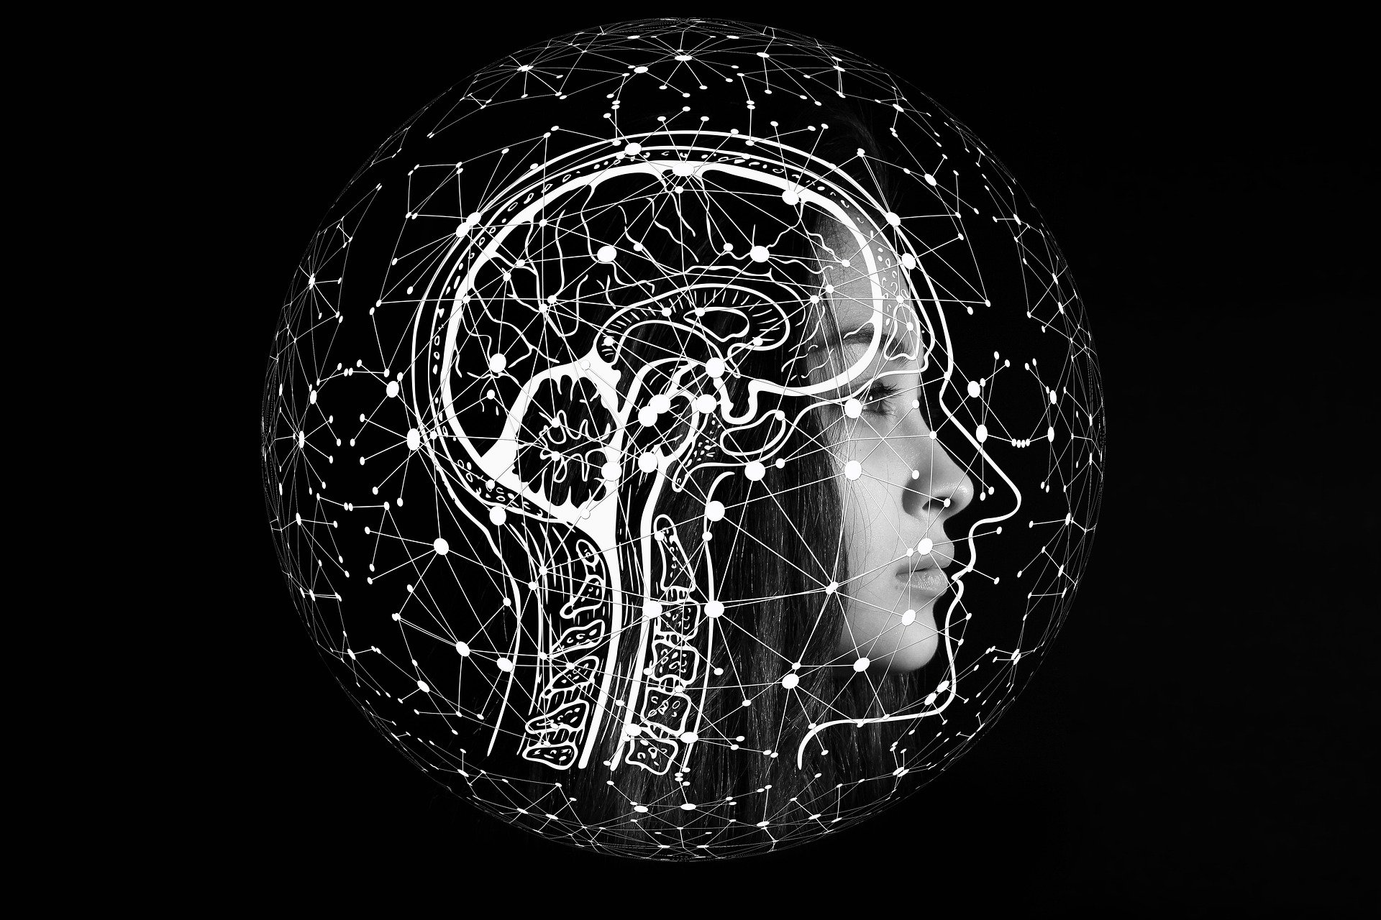






State-of-the-art models applied to travel recommendation
Project’s origins
For the American Express Hackathon Challenge 2020, we proposed an AI-based chatbot solution to help customers make better choices when planning their travel.
Our solution
By using the state-of-the-art deep learning models, we designed an intent prediction chatbot that understands customers’ needs and redirects them to the relevant information or human agents.
Results
After training the model on 732 intent-labelled questions, we tested the model using 161 other randomly selected questions. The fine-tuned Bert-base model gave 96.89% accuracy, outperforming the other models we had tested.
Future developments
Expose the chatbot to a mobile app, a web app or a website.
Add more complexity to labelling and diversify data.
Use the real customer datasets to better fit AmEx’s needs.
Hackathon Team
Soyeong Bak
Business & Data analyst
Dabeen Oh
Data scientist
Emmanuel Ren
Software engineer
Zhaoxuan Wu
Mentor
Notes:
To conclude, we used state-of-the-art deep learning models to build a very accurate model for our task of intent prediction.
We got 96.89% accuracy with the fine-tuned Bert-base model.
More insights on the performance of our model will be given during the demo. https://github.com/eren125/AmExChall2020
The next steps of the project will be to expose the chatbot on a more specialized frontend platform such as a mobile app and improve the data we feed in and make it more personalized to American Express needs.
But the results we got are still very relevant.
Without further redo, let’s move on to the DEMO

